Slide 1
Revising and Editing:
Sentence Structure and Language
SHSAT English - Week Two
Notes:
Cr: Arin Faruque for the questions and answers of ELA.

Slide 2
Aim: Identify and correct grammatically incorrect sentences. Identify the best wording based on context.
Do now: What are some examples of issues with sentences?

Slide 3
Sentence Structure

Slide 4
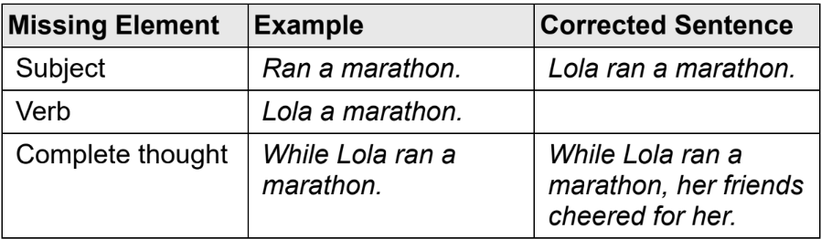
Fragments
A complete sentence must consist of at least a subject and a verb. If any of these elements are missing, the sentence is a fragment.
“While Lola ran a marathon” is an example of a dependent clause: it has a subject (Lola) and a verb (ran), but it does not express a complete thought because it starts with a subordinating conjunction (while). Notice what the word “while” does to the meaning: While Lola ran a marathon, what happened? To fix this type of fragment, eliminate the subordinating conjunction or join the dependent clause to an independent clause using a comma. Subordinating conjunctions are words and phrases such as since, because, therefore, unless, although, and due to.

Slide 5
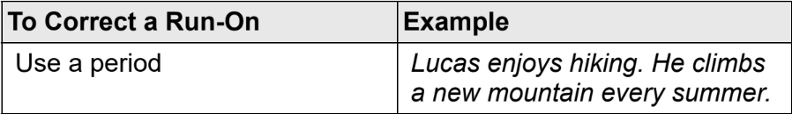
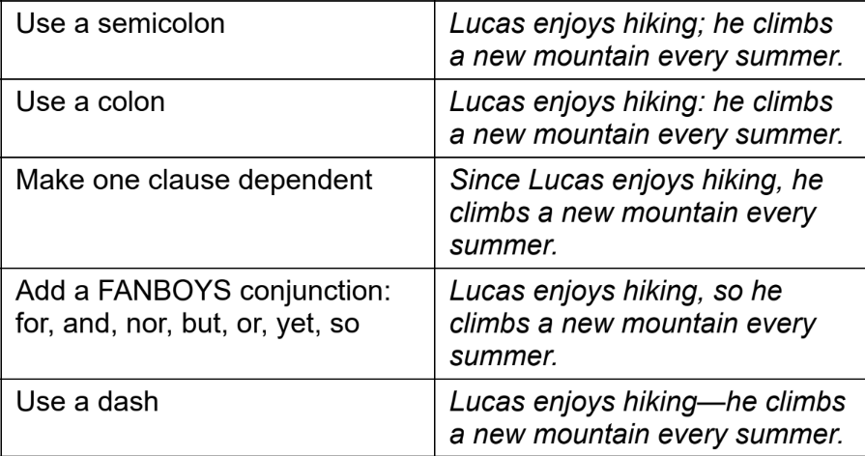
Run-ons
Unlike a dependent clause, an independent clause can stand on its own as a complete sentence. If a sentence has more than one independent clause, however, those clauses must be properly joined or the sentence is a run-on: Lucas enjoys hiking, he climbs a new mountain every summer.

Slide 6
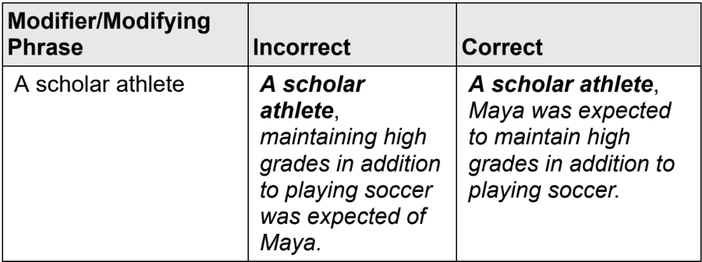
Modifier Placement
Modifier: word or phrase that describes, clarifies, or provides additional information about another part of the sentence. In order to be grammatically correct, the modifier must be placed as close to the word it describes as possible. A common way the SHSAT tests modifiers is with modifying phrases at the beginning of a sentence. Just like any other modifier, the phrase grammatically modifies whatever is right next to it in the sentence.
Example: While walking to the bus stop, the rain drenched Gina.
“While walking to the bus stop,” grammatically modifies “the rain,” but this creates a sentence that doesn’t make sense; the rain can’t walk to the bus stop.
→ “While walking to the bus stop, Gina was drenched by the rain.”

Slide 7
Subject-verb Agreement
A verb must agree with its subject in person (first, second, or third) and number (singular or plural).
The noun closest to the verb is not always the subject. Example: “The chair with the lion feet is an antique.” The verb’s actual subject is the singular noun chair, so the sentence is correct as written.
When a sentence includes two nouns, only the conjunction “and” forms a compound subject requiring a plural verb form:
Plural: Saliyah and Taylor are in the running club.
Singular: Either Saliyah or Taylor is in the running club.
Singular: Neither Saliyah nor Taylor is in the running club.
Collective nouns are nouns that name entities with more than one member. Even though these nouns represent more than one person, they are grammatically singular.
Example: The collection of paintings is one of the most popular art exhibits in recent years.

Slide 8
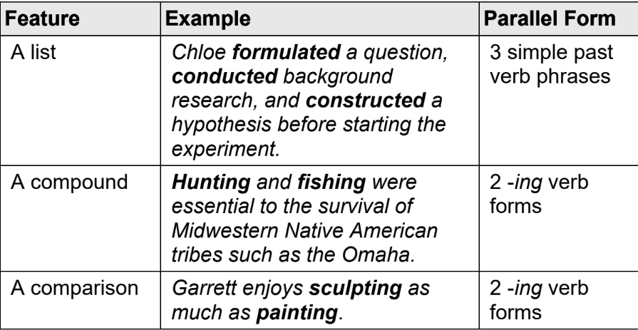
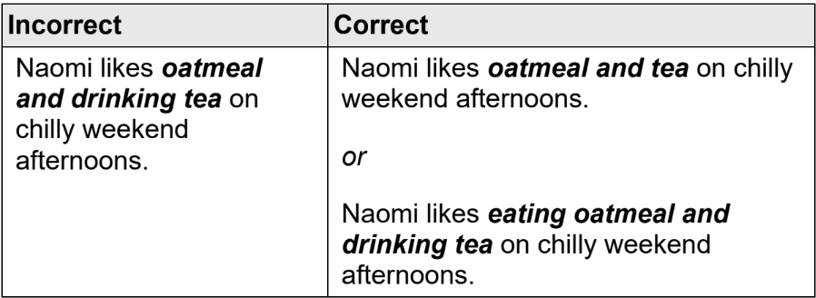
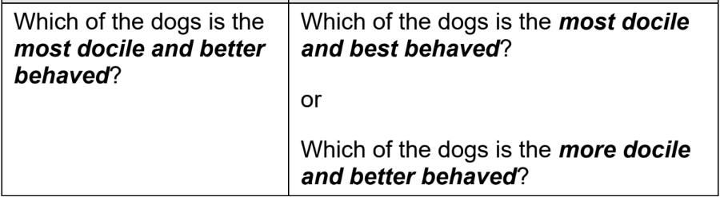
Parallelism
Tip: Check that the verb:
Reflects the correct tense (Does it fit the context?)
Agrees with the subject in person and number
Is parallel in form with other verbs in a series, list, or compound (if there is one in the sentence)
Verbs in a list, a compound, or a comparison must be parallel in form. Parallelism may also apply to any other part of speech. In general, any items in a list, compound, or comparison must be in parallel form.

Slide 9
Language

Slide 10
Conciseness
A concise sentence does not include any unnecessary words. All words must contribute to the meaning of the sentence; otherwise, they should be eliminated or replaced with more concise wording.
One common cause of wordiness is redundancy.
Example: “The new policy directly contributed to a crisis situation.”
A crisis is a type of situation, so there is no need to include both “crisis” and “situation.”
→ “The new policy directly contributed to a crisis.”
To answer Conciseness questions, choose the most concise grammatically correct option that conveys the writer’s intended meaning.
Identify the answer choice that creates the shortest sentence. (This will not always be the correct answer, but it is an efficient place to start.)
Identify words and phrases that have the same meaning (e.g., thoughtful and mindful or end result and final outcome). Find a choice that deletes one of the redundant expressions.

Slide 11
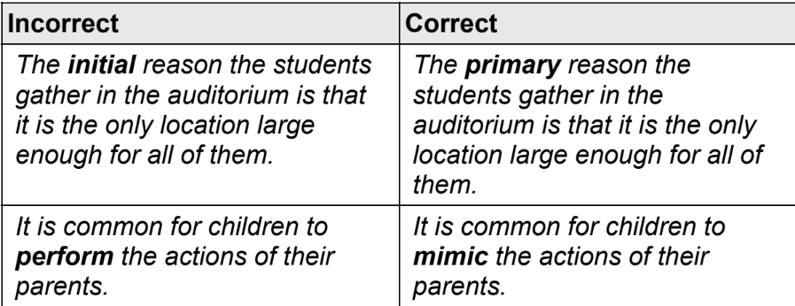
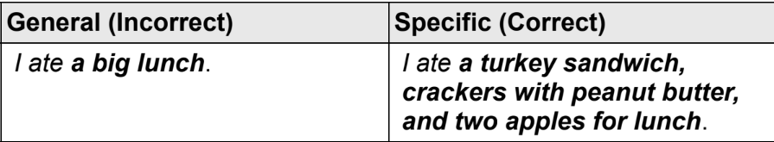
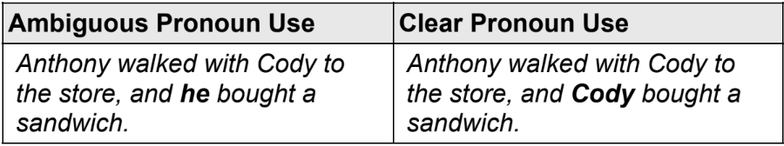
Precision
Detailed Wording
Word Choice
Ambiguous pronouns
Tip: Read the surrounding text to identify the writer’s intended meaning. Eliminate the answer choices that: (1) Do not convey the writer’s intended meaning, (2) Do not make sense in context, or (3) Create grammatical errors.
The SHSAT prefer specific information such as “a four-hour train ride” to more general statements such as “a long trip.”
Identify which word(s) to use in context and best convey the writer’s intended meaning.
A pronoun is ambiguous if its antecedent (the noun to which it refers) is either missing or unclear.

Slide 12
Style
A writer’s style is the way in which the writer demonstrates a general attitude about a topic or idea. Writers select specific words to best convey their intended messages. Oftentimes, the tone is more formal than casual, so you’ll need to eliminate answer choices that use informal words and phrases. For example, vague phrases such as “a lot of things” and “stay on top of” would not be in a correct answer choice.
Tip: Read the entire text to identify the writer’s general style. Eliminate the answer choices that:
Do not match the surrounding style
Create grammatical errors
Do not make sense in context
Do not convey the writer’s intended meaning

Slide 13
Fractions, Decimals, and Percentages
SHSAT Math - Week Two

Slide 14
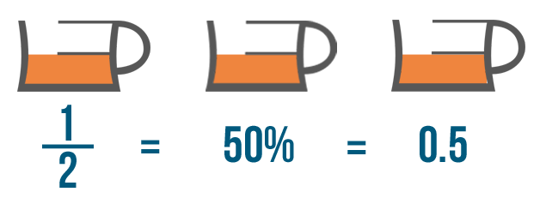
Quick refresher…
Fractions
Percentages
Decimals
Any number with a decimal point. Ex: 1.4, 9.7896
Written in the form a/b, to express a quantity as part of whole. Ex: ¼, 5/3
Written in the form x%, to express a quantity out of 100. Ex: 45%, 98.78%.

Slide 15
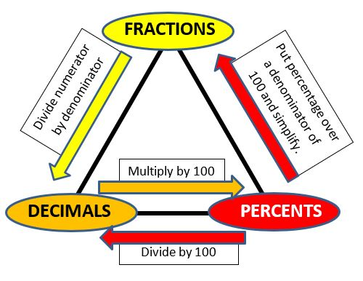
Converting
Let’s do an example!
Convert 0.37 to a fraction.
Use the place value of the decimal point to determine the denominator - in this case, it goes to hundredths, so the denominator is 100.
The number to the right of the decimal point is the numerator => 37/100.
Simplify if necessary (in this case it’s not).
Convert 6/25 to a percentage.
Multiply the denominator by a number so that it becomes 100. We have 25*4 = 100.
Multiply the numerator by the same number (so that the fraction doesn’t change). 6*4 = 24. That’s your answer! (24%)

Slide 16
GCF and LCM
Quick refresher:
Factor: a number that multiplies with another number to give the original number. In other words, a number that the original number is divisible by. Ex: 2 is a factor of 6 (2*3 = 6).
Multiple: a number that is divisible by the original number. Ex: 12 is a multiple of 6 (12/6 = 2).
Greatest Common Factor (GCF)
Lowest Common Multiple (LCM)
As the name suggests, it’s the largest number that the two numbers given are both divisible by. For example, the GCF of 36 and 48 is 12.
The smallest number that is divisible by the two numbers given. For example, the LCM of 12 and 15 is 60.

Slide 17
How to find the GCF and LCM? Prime factorization!
We’re gonna divide the given numbers by smaller prime numbers (mostly) such as 2, 3, and 5 until we can’t divide anymore. Here’s a demonstration with 36 and 48.
36 48
9 4 6 8
3 3 2 2 3 2 2 4
2 2
3 x 2 x 2 = 12
36 x 2 x 2 = 144

Slide 18
Using prime factorization to find the LCM and GCF
For the GCF, use all the factors that both numbers have. For example:
Find the GCF of 36 and 48.
Using prime factorization, we have:
36 = 2*2*3*3 or 2^2 * 3^2 => Two 2s and two 3s.
48 = 2*2*2*2*3 or 2^4 * 3 => Four 2s and one 3.
Both numbers have two 2s and one 3.
=> the GCF is the product of two 2s and one 3
=> GCF = 2*2*3 = 12.
Check your answer by dividing the two given numbers by your answer.
For the LCM, the answer is the larger number multiplied by whatever factors the smaller number has but the larger one doesn’t. For example,
Find the LCM of 36 and 48.
36 = 2*2*3*3 or 2^2 * 3^2 => Two 2s and two 3s.
48 = 2*2*2*2*3 or 2^4 * 3 => Four 2s and one 3.
48 has four 2s while 36 has only two, so we do not need to multiply by any 2s. However, 48 has one 3 while 36 has two 3s, so we need to multiply 48 by 3. => LCM = 48*3 = 144.
You can check your answer by dividing it by each number.

Slide 19
Examples
Find the LCM of 24 and 60.
24 - 2 3 2 2
60 - 2 2 3 5
24 x 5 = 120
24 -
2 12
2 6
3 2
2 x 2 x 2 x3
Find the GCF of 24 and 60.

